Slide 1
Policy Aware, Explainable AI for Open-Source Crisis Report Triage
Stakeholder Briefing | Sean Schoch
Problem
Model
Testing
Human Review

Slide 2
The operational problem: useful signal buried in noise
Useful Reports
Evacuations, damage, shelters, roads
Noise
Duplicate, emotional, unrelated posts
Risk
A missed report may matter more than extra review
Stakeholder need
Reduce review burden without hiding useful information
Prioritize likely informative crisis messages
Preserve accountability through human review
Design principle
The model is a triage aid, not an autonomous emergency-response decision-maker

Slide 3
Project Objective: route likely informative reports to humans
Public Crisis Message
Text preprocessing
Classifier + Threshold
Human review queue
Informative
Positive Class
Other Labels
Negative Class
False Negatives
Primary Risk
Do not discard
Policy

Slide 4
Data and Modeling Approach
5,149
Unique Messages
5
Crisis Events
2,711
Positive Class
2,438
Negative Class
80/20
Initial Split
Events: Colorado wildfires, Costa Rica earthquake, Boston bombings, Alberta floods, Singapore haze
Baseline
TF-IDF + Logistic regression
Tuned word model GridSearchCV
Hybrid model
Word + character n-grams

Slide 5
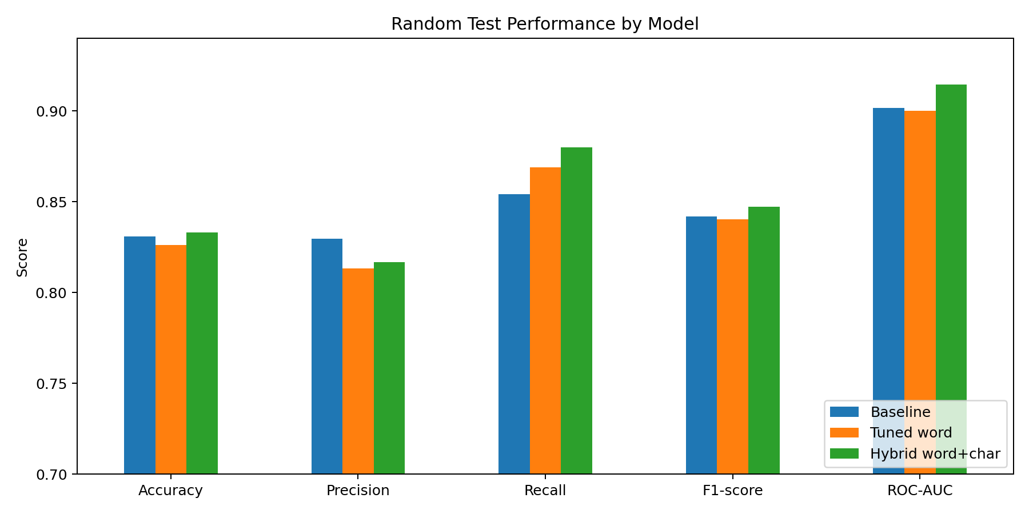
Random Test Results Looked Strong
0.842
Baseline F1
0.847
Hybrid F1
0.880
Hybrid recall
65
False Negatives
At threshold 0.47, recall rose to 0.897 and false negatives dropped to 56

Slide 6
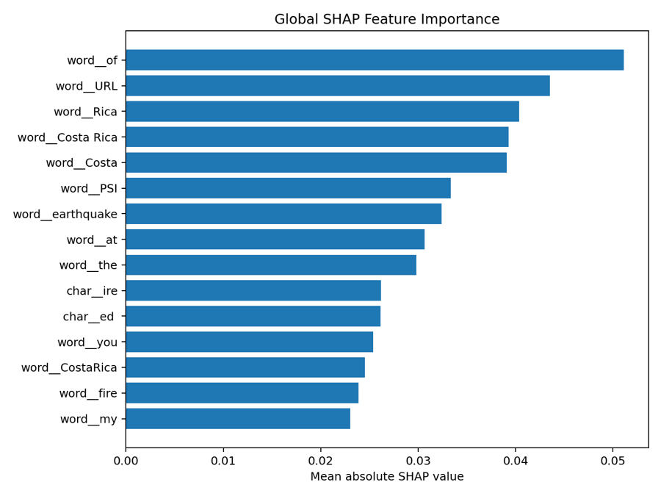
Explainability exposed event-specific dependence
What SHAP helped confirm
Model cues were inspectable
Some cues were operationally meaningful
Others were event-specific vocabulary
Explanations do not prove fairness or correctness
Concern: words like Costa Rica, earthquake, fire, and PSI can reflect crisis identity as much as informativeness

Slide 7
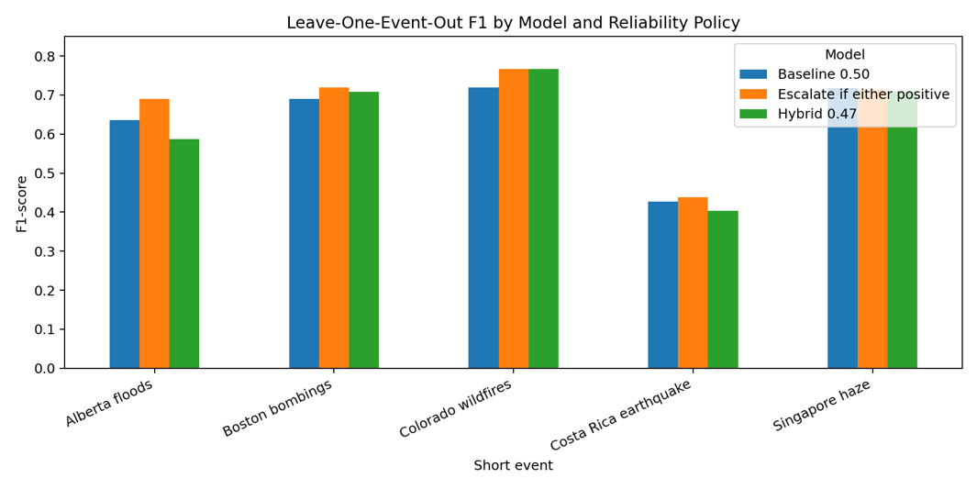
Robustness test: train on four crises, test on the fifth
0.628
Pooled Baseline F1
0.634
Pooled Hybrid F1
0.661
Either model F1
Variable
Key issue
Random-split performance was optimistic; event-level generalization is the real test.

Slide 8
Debugging finding: complementary errors suggested a guardrail
375
Hybrid correct when baseline missed
316
Baseline correct when hybrid missed
185
Extra informative messages caught
52.1%
Review Rate
928
False Negatives Down from 1,113
Baseline flags positive
Hybrid flags positive
Elevate to human review
or
Guardrail: use models to expand review coverage, not to suppress reports.

Slide 9
Recommended deployment: cautious, monitored, human-in-the-loop
FastAPI service
Model + Threshold
Review Queue
Audit Dashboard
Return prediction, probability, model version, and review recommendation
Keep thresholds configurable and stakeholder-approved
Monitor drift, review rate, event-level errors, and rollback triggers
Use security controls: authentication, input validation, rate limits, minimal logging

Slide 10
Conclusion: feasible triage support, not autonomous filtering
Yes
Feasible baseline
0.897
Best random recall
0.658
Cross-event recall
Generalize
Core limitation
Final Recommendation
Deploy only as a monitored human-review prioritization system that preserves borderline reports, audits event-level errors, and never automatically discards crisis messages.

